Slide 2











$$x^{(0)}$$
$$x^{(1)}$$
$$w_{0}$$
$$w_{1}$$
$$w_{c}$$
$$=$$
$$f_{w0}$$
$$f_{w1}$$
$$f_{wc}$$
$$x^{(m−1)}$$
(m,n)
(n,c)
(m,c)
$$f_{w}=XW$$
prediction
c=number of classes

Slide 3
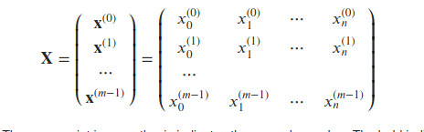

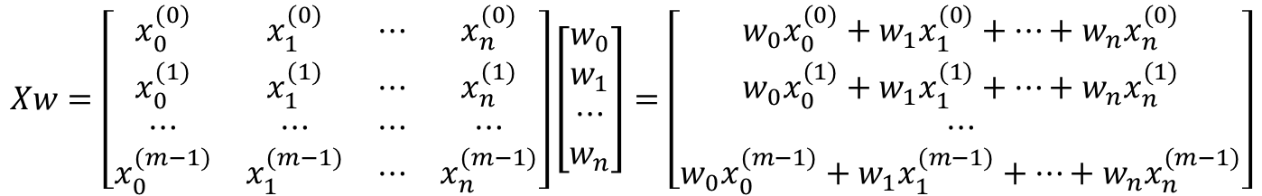
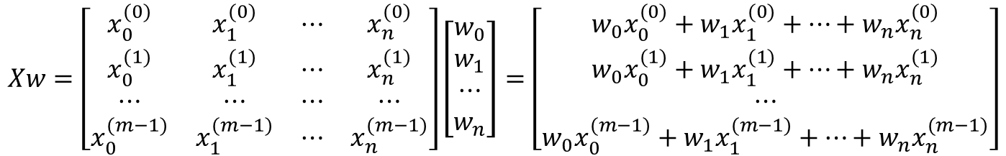
$$X= \left(\begin{matrix}x_{0}^{(0)} & ⋯ & x_{n}^{(0)} \\ ⋮ & ⋱ & ⋮ \\ x_{0}^{(m−1)} & ⋯ & x_{n}^{(m−1)}\end{matrix}\right)$$
$$Xw=\left[\begin{matrix}x_{0}^{(0)} & x_{1}^{(0)} & ⋯ & x_{n}^{(0)} \\ x_{0}^{(1)} & x_{1}^{(1)} & ⋯ & x_{n}^{(1)} \\ ⋯ & ⋯ & ⋯ & ⋯ \\ x_{0}^{(m−1)} & x_{1}^{(m−1)} & ⋯ & x_{n}^{(m−1)}\end{matrix}\right]\left[\begin{matrix}w_{0} \\ w_{1} \\ ⋯ \\ w_{n}\end{matrix}\right]=\left[\begin{matrix}w_{0}x_{0}^{(0)}+w_{1}x_{1}^{(0)}+…+w_{n}x_{n}^{(0)} \\ w_{0}x_{0}^{(1)}+w_{1}x_{1}^{(1)}+…+w_{n}x_{n}^{(1)} \\ ⋯ \\ w_{0}x_{0}^{(m−1)}+w_{1}x_{1}^{(m−1)}+…+w_{n}x_{n}^{(m−1)}\end{matrix}\right]$$
$$Xw=\left[\begin{matrix}x_{0}^{(0)} & x_{1}^{(0)} & ⋯ & x_{n}^{(0)} \\ x_{0}^{(1)} & x_{1}^{(1)} & ⋯ & x_{n}^{(1)} \\ ⋯ & ⋯ & ⋯ & ⋯ \\ x_{0}^{(m−1)} & x_{1}^{(m−1)} & ⋯ & x_{n}^{(m−1)}\end{matrix}\right]\left[\begin{matrix}w_{0} \\ w_{1} \\ ⋯ \\ w_{n}\end{matrix}\right]=\left[\begin{matrix}w_{0}x_{0}^{(0)}+w_{1}x_{1}^{(0)}+…+w_{n}x_{n}^{(0)} \\ w_{0}x_{0}^{(1)}+w_{1}x_{1}^{(1)}+…+w_{n}x_{n}^{(1)} \\ ⋯ \\ w_{0}x_{0}^{(m−1)}+w_{1}x_{1}^{(m−1)}+…+w_{n}x_{n}^{(m−1)}\end{matrix}\right]$$

Slide 4
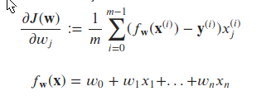












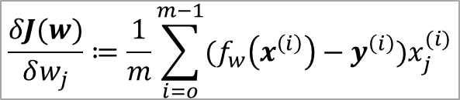





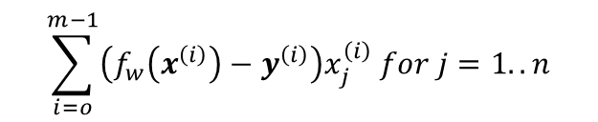





$$\frac{δJ(w)}{δw_{j}}≔\frac{1}{m}\sum_{i=o}^{m−1}{(f_{w}\left(x^{\left(i\right)}\right)−y^{\left(i\right)})x_{j}^{(i)}}$$
$$\sum_{i=o}^{m−1}{\left(f_{w}\left(x^{\left(i\right)}\right)−y^{\left(i\right)}\right)x_{j}^{\left(i\right)} for j=1..n}$$
$$f_{w}\left(x^{\left(i\right)}\right)$$
$$(f_{w}\left(x^{\left(i\right)}\right)−y^{\left(i\right)})$$
$$x^{(0)}$$
$$x^{(1)}$$
$$f_{w}$$
$$f_{w}$$
$$−$$
$$y$$
$$=$$
$$e$$
$$\frac{1}{m}$$
$$w$$
$$=$$
$$x^{(0)}$$
$$x^{(1)}$$
$$x^{(m−1)}$$
$$e$$
$$=$$
$$dw$$
$$x^{(m−1)}$$
(m,n)
(n,1)
(m,1)
(m,1)
(m,1)
(m,1)
(n,m)
(m,1)
(n,1)
$$f_{w}=Xw$$
$${e=f}_{w}−y$$
$$dw=\frac{1}{m}X^{T}e$$
prediction
error
gradient

